Slide 1
AI and Deep Learning with TensorFlow
1. Introduction
By Digish Gabhawala

Slide 2
Introduction

Slide 3
Let’s Get ready
Python : https://www.python.org/downloads/
Tensorflow : https://www.tensorflow.org/install/pip
Other important libraries : numpy, pandas, matplotlib,sklearn,keras
Github : https://github.com/digishgabhawala/deepLearningTraining/tree/master/Intro
Notebook Link: https://mybinder.org/v2/gh/digishgabhawala/deepLearningTraining/master?filepath=Intro

Slide 5
What is planned
Introduction (Today)
Motivation (Today)
Sample Code and setup (Today)
Single Layer Perceptrons
Multi Layer Perceptorns
Fully conected network
CNNs
RNNS
LSTM

Slide 6
What is planned
Saving and Loading Models
Building of deep networks
Keras
Image Classification
Text classification
Regression

Slide 7
What is planned
Different Loss functions
Different type of Layers
Different type of Optimizers
Different type of Metrices
Hyperparameters

Slide 8
What is not planned
Details about Basic Machine learning algorithms
Maths and Formulaes implementation
Stastistics and Advanced Mathematics
Data Preprocessing
Alternatives like Pytorch

Slide 9
What is expected at start
Basics about Python (Preferred) / any programming language (Would help you to understand)
Basics about Data Preprocessing and visulization
Basics of numpy , pandas, sklearn, matplotlib

Slide 10
Standard / Known use cases
Social Media
Recommendation Engine / Search engine/ Translate
Chatbots / Camera / Image to Text
Self Driven Cars
Fraud Detection
Agriculture
Healthcare

Slide 11
Fun Facts
Artificial Intelligence In Sports – A Computer System That Defeats A World Champion – Deep Blue
An Artificial Intelligence system developed at Texas A&M University permits computer programmers to write basic algorithms that can examine extensive footage and find missing people in under two hours.
There was experiment in Japan in 2018 to read mind using AI

Slide 12
Fun Facts
Uganda’s Queen Elizabeth National Park uses Predictive modeling to predict poaching threat levels. Such models can be used to generate efficient and feasible patrol routes for the park rangers.
the Berlin-based agricultural tech startup PEAT has developed a deep learning algorithm-based application called Plantix which can identify defects and nutrient deficiencies in the soil.
Musenet can compose music based on AI

Slide 13
Fun Facts
DeepMind’s AI-based AlphaGo software, which is known for defeating Lee Sedol, the world champion in the game of GO, is considered to be one of the most significant accomplishment in the field of AI.
Shortly after the victory, DeepMind created an advanced version of AlphaGo called AlphaGo Zero which defeated the predecessor in an AI-AI face off. Unlike the original AlphaGo, which DeepMind trained over time by using a large amount of data and supervision, the advanced system, AlphaGo Zero taught itself to master the game.

Slide 14
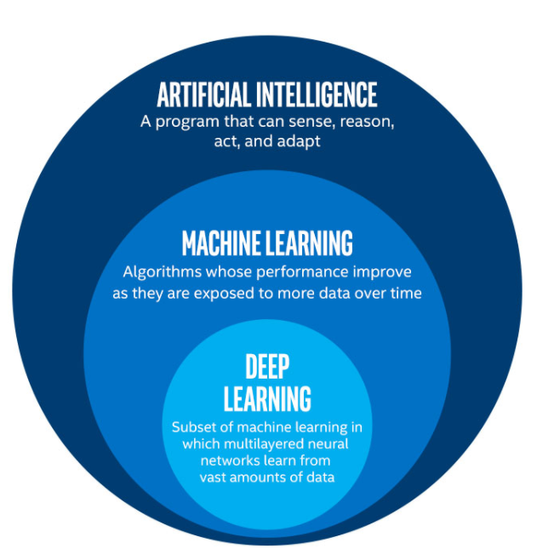

Slide 15
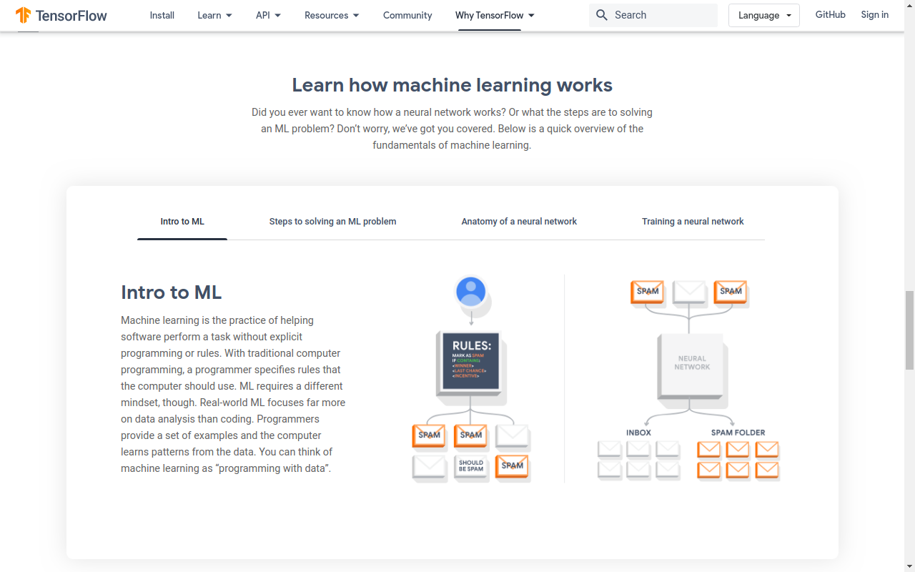
How ML Works - 1

Slide 16
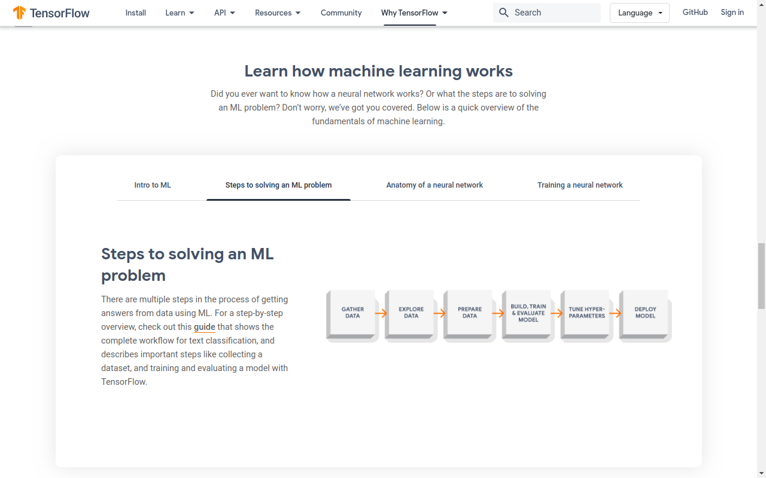
How ML Works - 2

Slide 17
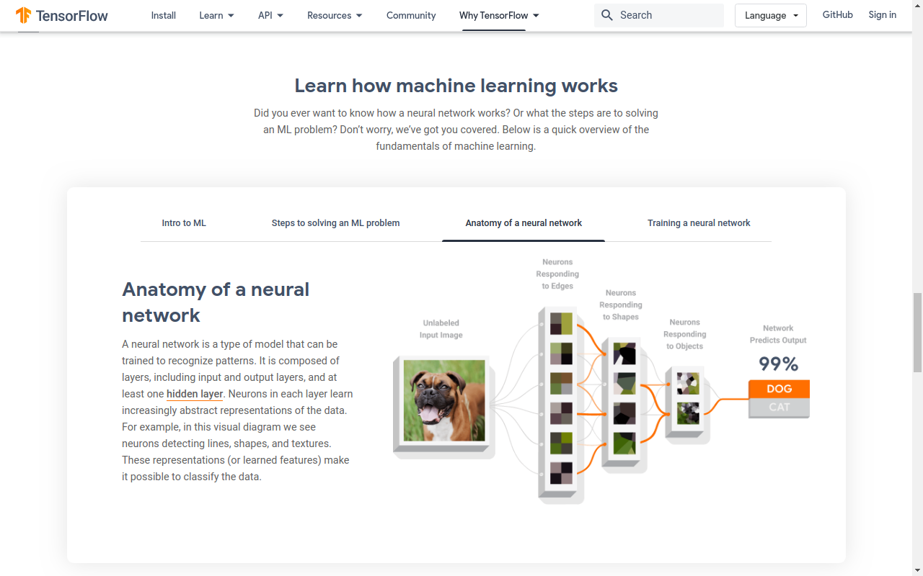
How ML Works - 3

Slide 18
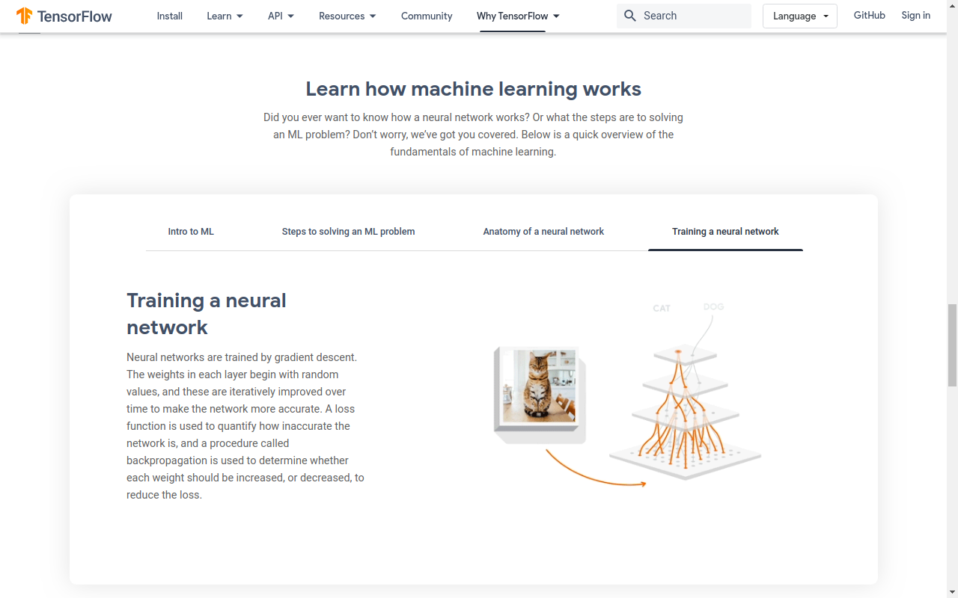
How ML Works - 4

Slide 19
Binary Classification Example
Dataset : https://archive.ics.uci.edu/ml/datasets/banknote+authentication
Notebook: https://mybinder.org/v2/gh/digishgabhawala/deepLearningTraining/master?filepath=Intro%2Fbinary_classification_bank_notes.ipynb

Slide 20
Multi Classification Example
Dataset : https://archive.ics.uci.edu/ml/datasets/Wine
Notebook: https://mybinder.org/v2/gh/digishgabhawala/deepLearningTraining/master?filepath=Intro%2Fmulti_classification_wines.ipynb

Slide 21
Mnist Example
Data: http://yann.lecun.com/exdb/mnist/
Dataset : https://www.tensorflow.org/datasets/catalog/mnist
Notebook:
https://mybinder.org/v2/gh/digishgabhawala/deepLearningTraining/master?filepath=Intro%2Fmnist.ipynb

Slide 22
Q n A

Slide 23
Poll
When was term Artificial Intelligence coined?
A 1950-60
B 1960-70
C 1970-80
D 1980+

Slide 24
Poll
Why was Machine learning not getting much famous till recent times?
A There was not enough data
B There were not good algorithms
C There was not enough computation power
D All of above

Slide 25
Poll
How is your backgroud related to AI/ML with TF?
A. I haven’t heard of it
B. I know about it but never used it
C. I have used ML but never used Deep Learning
D. I have used Deep Learning but haven’t used Tensorflow
E. I have used Tensorflow and I would be able to help you in session

